Slide 1
Exception handling
CSC103 Programming Fundamentals

Slide 2
Today’s lecture
Exceptions and exception handling
Try-throw-catch template
Exception classes
Exception handling model
Declaring exceptions
Throwing exceptions
Catching exceptions
The finally clause
Rethrowing exceptions
Chained exceptions

Slide 3
introduction
Exception handling enables a program to deal with exceptional situations and continue its normal execution
Runtime errors occur while a program is running (JVM detects an operation that is impossible to carry out)
Examples:
Accessing an array using an index that is out of bounds (ArrayIndexOutOfBoundsException)
Entering a double value when your program expects an integer (InputMismatchException)

Slide 4
exceptions
In Java, runtime errors are THROWN as exceptions
Exception: an object that represents an error or a condition that prevents execution from proceeding normally
If not handled, the program will terminate abnormally
Advantages:
The core advantage of exception handling is to maintain the normal flow of the application.
Enables a method to throw an exception to its caller, enabling the caller to handle the exception
Separates the detection of an error from the handling of an error
Example
statement 1;
statement 2;
statement 3;
statement 4;
statement 5;//exception occurs
statement 6;
statement 7;
statement 8;
statement 9;
statement 10;

Slide 5
Java Exception Handling Example and common scenarios
public class JavaExceptionExample{
public static void main(String args[]){
try{
//code that may raise exception
int data=100/0;
}catch(ArithmeticException e){
System.out.println(e);
}
//rest code of the program
System.out.println("rest of the code...");
}
}
A scenario where ArithmeticException occurs:
int a = 100/0;
A scenario where NullPointerException occurs:
String s=null;
System.out.println(s.length())
A scenario where NumberFormatException occurs
String s="abc";
int i=Integer.parseInt(s);//NumberFormatException
A scenario where ArrayIndexOutOfBoundsException occurs
int a[]=new int[5];
a[10]=50; //ArrayIndexOutOfBoundsException
Exception in thread main java.lang.ArithmeticException:/ by zero
rest of the code...

Slide 6
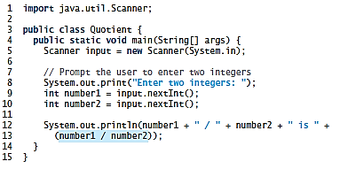

Exception handling
Exceptions are thrown from a method
The caller of the method can catch and handle the exception

Slide 7
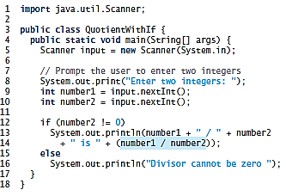

Handling the exception using if statement

Slide 8

The problem

Slide 9

The solution

Slide 10
Exception handling
The value thrown in the example, new ArithmeticException(“Divisor cannot be zero”), is an exception
The execution of a throw statement is called throwing an exception
In this example, the exception class is java.lang.ArithmeticException
The constructor ArithmeticException(str) is invoked to construct an exception object, where str is a message that describes the exception
When an exception is thrown, the normal flow execution is interrupted
Throwing: passing an exception from one place to another
Analogous to a method call (but it calls the catch block)
The method call is contained in a try and catch block
Try block: code that is executed in normal circumstances
Catch block: code that catches the exception; handles the exception
Analogous to method definition with a parameter that matches the type of the value being thrown

Slide 11
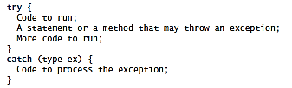
Exception handling (Contd.)
Catch-block parameter: the identifier ex in the catch block header
The type (e.g. ArithmeticException) preceding ex specifies what kind of exception the catch block can catch
The thrown value can be accessed from this parameter in the body of catch block
Template of try-throw-catch
Throwing an exception:
A throw statement in a try block
Method invocation

Slide 12
Example: library method throwing exception

Slide 13
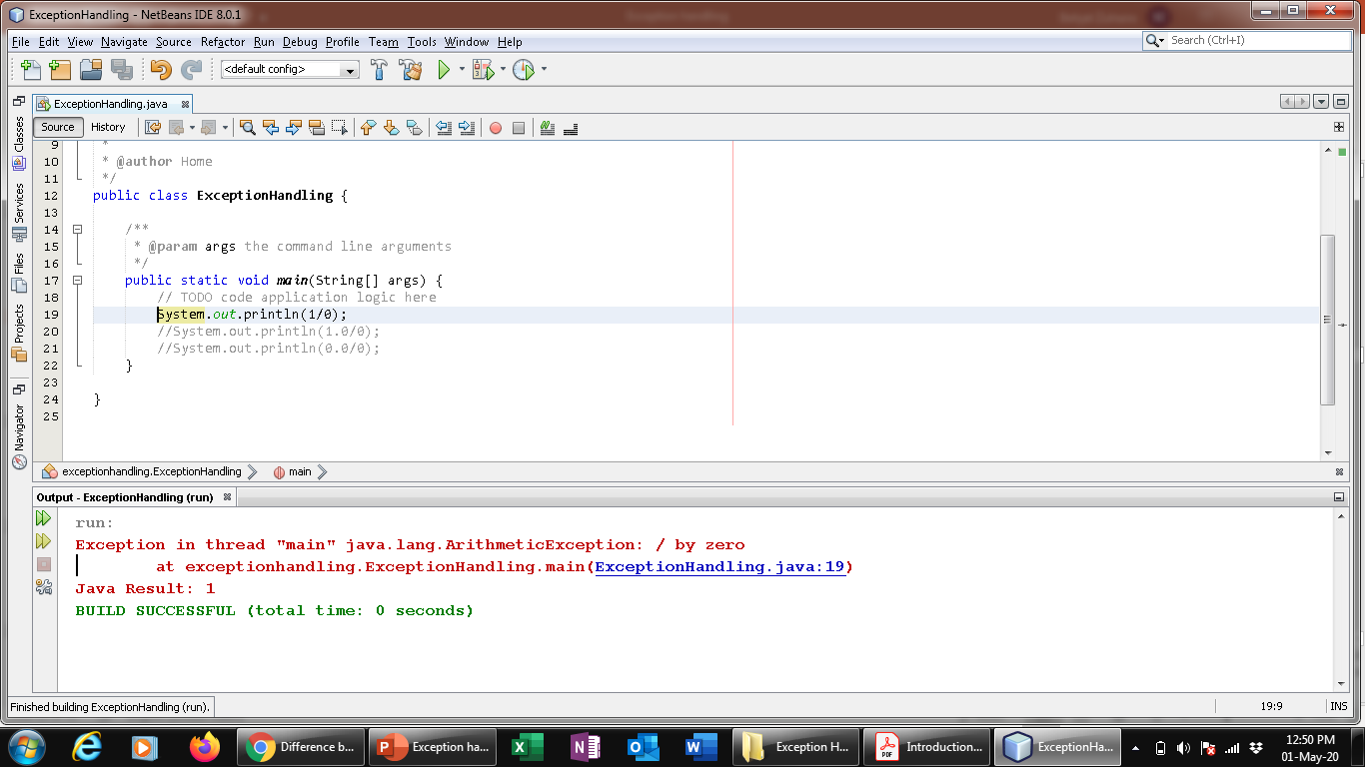
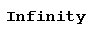
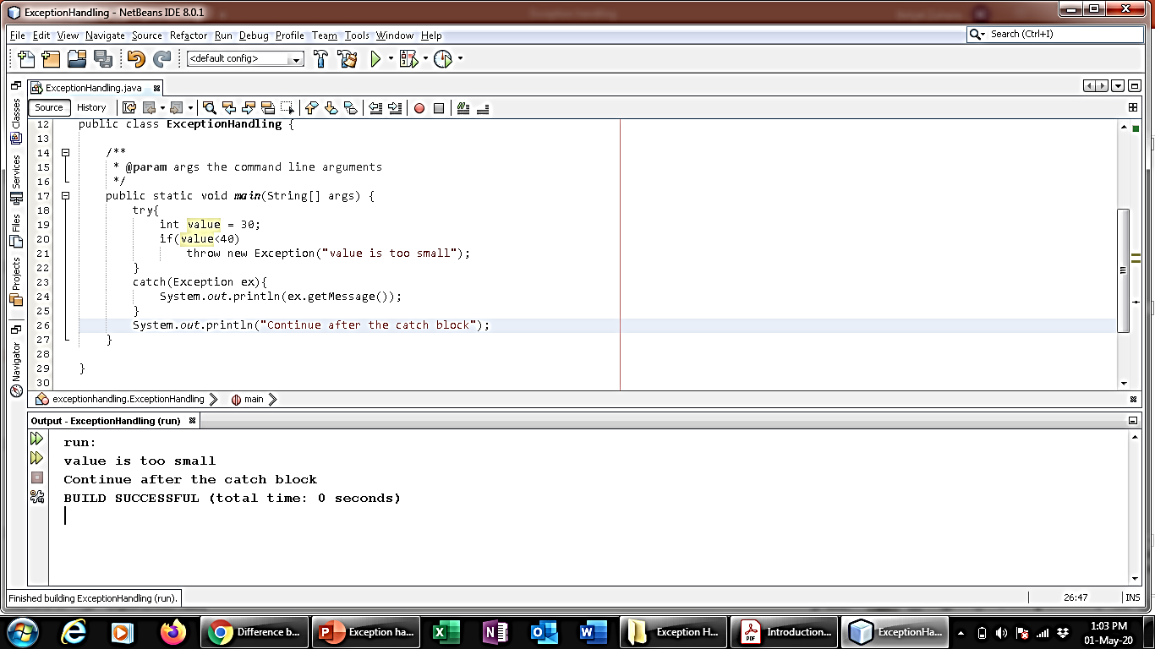
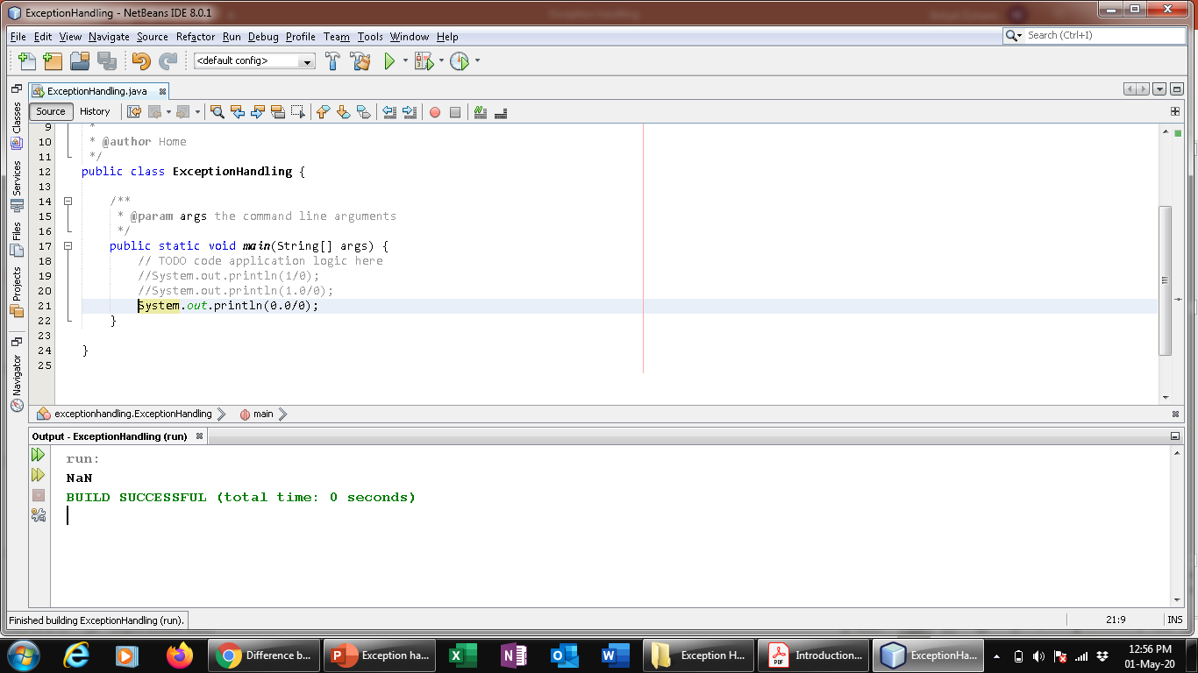
examples
System.out.println(0.0 / 0);

Slide 14
Try – catch – finally Syntax
try{ … }
catch(){
}
finally{
}

Slide 15
Four Possibilities of exception
Default Throw and Default Catch
Default Throw and our Catch
Our Throw and Default Catch
Our Throw and Our Catch

Slide 16
Default Throw and Default Catch
int[ ] abc = new int[5];
System.out.println("First Line"+abc[5]); //ArrayIndexOutOfBoundsException
System.out.println(2/0);//ArithmeticException
System.out.println("Last Line");

Slide 17
Default Throw and our Catch
catch can be more than one associated with one try
Each try must have one catch(){…}
try{
String st = null; //NullPointerException
int[] abc = null; //NullPointerException
System.out.println("First Line"+st.length());
System.out.println("Last Line after exception");
//System.out.println(20/0);//ArithmeticException: Java by default make its object
}
catch(NullPointerException ex){
System.out.println("!!!No Reference to Object!!!");
}

Slide 18
Our Throw and Default Catch
Explicit Throw: A program can explicitly throw an Exception using the "throw" statement besides the implicit exception thrown
Syntax: throw <throwableInstance>
Example: throw new ArithmeticException("Division by Zero")
int balance = 1000;
int withdrawlAmount = 3000;
if(balance < withdrawlAmount){
throw new ArithmeticException("<<<Insufficient Balance...>>>");
}
balance = balance - withdrawlAmount;
System.out.println("Sucessfully Completed");

Slide 19
Our Throw and Our Catch
try{
int balance = 1000;
int withdrawlAmount = 3000;
if(balance < withdrawlAmount){
throw new ArithmeticException("Insufficient Balance...");
}
balance = balance - withdrawlAmount;
System.out.println("Sucessfully Completed");
}
catch(ArithmeticException e){
System.out.println("Exception: "+ e.getMessage());
}

Slide 20
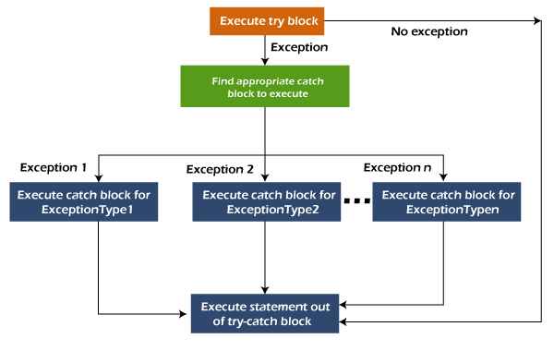
Java Multi-catch block
A try block can be followed by one or more catch blocks
At a time only one exception occurs and at a time only one catch block is executed
All catch blocks must be ordered from most specific to most general, i.e. catch for ArithmeticException must come before catch for Exception.

Slide 21
Example
public class MultipleCatchBlock1 {
public static void main(String[] args) {
try{
int a[]=new int[5];
a[5]=30/0;
}
catch(ArithmeticException e)
{
System.out.println("Arithmetic Exception occurs");
}
catch(ArrayIndexOutOfBoundsException e)
{
System.out.println("ArrayIndexOutOfBounds Exception occurs");
}
catch(Exception e)
{
System.out.println("Parent Exception occurs");
}
System.out.println("rest of the code");
}
}

Slide 22
Exception types
Exception are objects; Objects are defined using classes
Many predefined exception classes in the Java API; one can define one’s own exception classes
The root class for exceptions is java.lang.Throwable

Slide 23
Exception classes
System errors
Exceptions
Runtime Exceptions
Thrown by JVM
Represented in Error class
Caught & handled by your program
Represented in Exception class
Caught & handled by your program
Represented in RuntimeException class
Describes internal system errors
Describes errors caused by your program & by external circumstances
Describes programming errors

Slide 24
Un/checked exceptions
Unchecked exceptions: RuntimeException, Error
Programming logic errors that are unrecoverable; not mandatory to catch or declare
NullPointerException: if you access an object through a reference variable before an object is assigned to it
IndexOutOfBoundsException: if you access an element in an array outside the bounds of array
Checked exceptions: all other exceptions
Compiler forces the programmer to check
Dealt in
Try-catch block
Declared in the method header

Slide 26
More on exception handling
A handler for an exception is found by propagating the exception backward through a chain of method calls, starting from the current method
Exception-handling model in Java
Declaring an exception
Throwing an exception
Catching an exception

Slide 27
Declaring exceptions
Every method must state the types of checked exceptions it might throw. This is known as declaring exceptions.
Unchecked exceptions need not be declared explicitly in the method
Use keyword throws in the method header

Slide 28
Throwing exceptions
A program that detects an error can create an instance/object of an appropriate exception type and throw it – throwing exception
Each exception class has at least 2 constructors:
A non-argument constructor
An argument constructor
Exception message can be obtained using getMessage()

Slide 29
Catch/declare checked exceptions

Slide 30
Catching exceptions
An exception can be caught and handled in a try-catch block
In case no exceptions are thrown, catch block(s) are skipped
Exception handler: The code that handles the exception
Found by propagating the exception backward through a chain of method calls, starting from the current method

Slide 31
Order of exceptions
The order in which exceptions are specified in catch blocks is important.
A compile error: if a catch block for a superclass type appears before a catch block for a subclass type

Slide 32
Catching exceptions/ Exception Propagation
An exception is first thrown from the top of the stack
If it is not caught, it drops down the call stack to the previous method.
If not caught there, the exception again drops down to the previous method, and so on until they are caught or until they reach the very bottom of the call stack. This is called exception propagation

Slide 33
Catching exceptions/ Exception Propagation
If the exception type is Exception3, it is caught by the catch block for handling exception ex3 in method2. statement5 is skipped, and statement6 is executed.
If the exception type is Exception2, method2 is aborted, the control is returned to method1, and the exception is caught by the catch block for handling exception ex2 in method1. statement3 is skipped, and statement4 is executed.
If the exception type is Exception1, method1 is aborted, the control is returned to the main method, and the exception is caught by the catch block for handling exception ex1 in the main method. statement1 is skipped, and statement2 is executed.
If the exception type is not caught in method2, method1, or main, the program terminates, and statement1 and statement2 are not executed.

Slide 34
Getting information from exceptions

Slide 35
The finally clause
The finally clause is always executed regardless whether an exception has occurred or not
Three possible cases:
No exception in try block, finalStatements is executed, & the next statement after the try statement is executed
An exception in try block, caught in catch block, the rest of the statements in try block are skipped, catch block is executed, & finally clause is executed. The next statement after the try statement is executed
An exception in try block, not caught in catch block, the other statements in the try block are skipped, the finally clause is executed, & the exception is passed to the caller method
try {
statement1;
statement2;
statement3;
}
catch (Exception1 ex1) {
statement4;
}
finally {
statement5;
}
statement6;

Slide 36
When to use exceptions
A method should throw an exception if the error needs to be handled by its caller
Exception handling separates error-handling code from normal programming tasks
Makes program easier to read and to modify
Drawback: more time, more resources
Simple errors that may occur in individual methods are best handled without throwing exceptions
Use try-catch block while dealing with unexpected error conditions

Slide 37
Rethrowing exceptions
Rethrowing exception:
If the handler cannot process the exception
If the caller must be notified of the exception

Slide 38
Example
public class Demo {
public static void test1() {
System.out.println("The Exception in test1() method");
throw new ArithmeticException("(ArithmeticException) thrown from test1() method");
}
public static void test2(){
try {
test1();
} catch(ArithmeticException e) {
System.out.println("Inside test2() method");
throw e;
}
}
public static void main(String[] args) {
try {
test2();
} catch(ArithmeticException e) {
System.out.println("Caught in main " +e.getMessage());
//e.printStackTrace();
}
}
}
The Exception in test1() method
Inside test2() method
Caught in main (ArithmeticException) thrown from test1() method

Slide 39
Chained exceptions
Throwing an exception along with another exception forms a chained exception

Slide 40
recap
Exception handling
Exception handling model
Declaring, throwing, & catching exceptions
Exception types
The finally clause
Rethrowing exceptions
Chained exceptions

